Slide 1
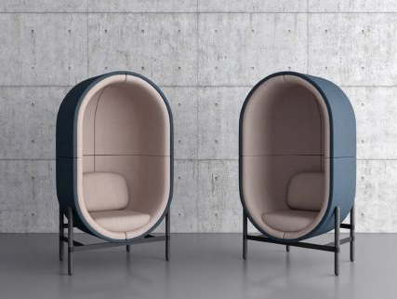
higher Design & Manufacture
Course Introduction

Slide 2



Welcome to higher design & manufacture
The course has two areas of study:
  DESIGN
    Study of the design process from brief to design proposal.
    Develop your skills in initiating, articulating and communicating design proposals.
    You will explore and refine design proposals using design/make/test processes.
    You will apply your knowledge of materials, processes and design factors to reach a viable solution.
  MANUFACTURE
    Study of the manufacture of commercial products.
    Develop your knowledge of materials, manufacturing and production processes.
    Develop your knowledge and understanding required to develop viable design proposals for a commercial product and to plan its production.

Slide 3
Skills, knowledge & understanding
The following provides a broad overview of the subject skills, knowledge and understanding.
  Researching and evaluating existing product types.
  Selecting and using a range of research techniques and evaluating their usefulness.
  Selecting and applying a range of idea-generation techniques.
  Writing a detailed specification based on research.
  Applying a range of creative design skills when refining and resolving product design tasks that cover key design challenges.
  Selecting and using graphic techniques to visually represent design solutions, justifying the choice of techniques.

Slide 4
Skills, knowledge & understanding
  Selecting, using and evaluating a range of simple modelling and manufacturing techniques to represent design ideas in three dimensions.
  Planning the manufacture of a commercial product and analysing its effectiveness.
  Selecting and using a range of tools, equipment, software and materials for designing, making and testing models and prototypes.
  Evaluating personal design proposals and associated manufacturing practicalities, and applying suggestions for improvement.
  Developing broad knowledge and understanding of the impact of a range of design and manufacturing technologies on our environment and society.
  Critically evaluating a range of factors that influence the design and manufacture of products.
  Developing knowledge and understanding of a broad range of industrial and commercial manufacturing processes and the properties and uses of materials.

Slide 5
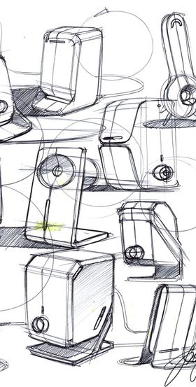
Course assessment structure
Question Paper
  Considerable step up from Nat5 level questions.
  A total of 80 marks out of 170 marks (approx. 47%).
  It will assess knowledge and understanding from the following areas of design and manufacture
      Design: 30-50 marks
      Materials and Manufacture: 26-42 marks
      Impact of design and manufacturing technologies on society, the environment and the world of work: 4-8 marks.

Slide 6
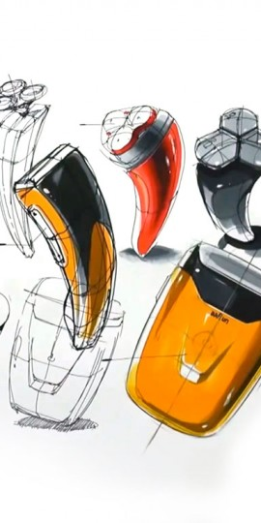
Course assessment structure
Course Assignment
  A total of 90 marks out of 170 marks (approx. 53%).
  The assignment assesses your ability to apply design skills to develop a proposal according to a set brief.
  It will allow you demonstrate the skills, knowledge and understanding previously mentioned.
  NOTE: there is NO manufacture of your project required by the SQA. It is a purely design assignment.

Slide 7

Course assignment
Marks for the assessment are awarded as follows:
Carrying out research into a given brief | 5 marks
Producing a specification | 3 marks
Generating initial ideas | 8 marks
Exploring ideas | 12 marks
Refining ideas | 6 marks
Applying knowledge and understanding of materials and assembly processes | 10 marks
Applying knowledge and understanding of design | 12 marks
Applying graphic techniques | 12 marks
Demonstrating practical modelling skills | 8 marks
Producing a plan for commercial manufacture | 6 marks
Applying modelling techniques | 6 marks

Slide 8

Theory topics
  DESIGN
    The Design Team
    Design Factors
    The Design Process
    Design Briefs
    Design Specification
    Idea Generation Techniques
    Evaluation Techniques
    Just in Time Production
    Manufacturing Systems
    CAD, CAM and CIM
    Product Lifecycle
    Graphics in the Design Process
    Environmental Impact
    Modelling in the Design Process
The following general topics will be covered over June and leading up to the Prelim after Christmas.

Slide 9
Theory topics
  MANUFACTURE
    Materials and Processes
        Wood
        Metal
        Plastic
    Assembly methods used in commercial manufacture
    Production and Planning Systems
The following general topics will be covered over June and leading up to the Prelim after Christmas.

Slide 10
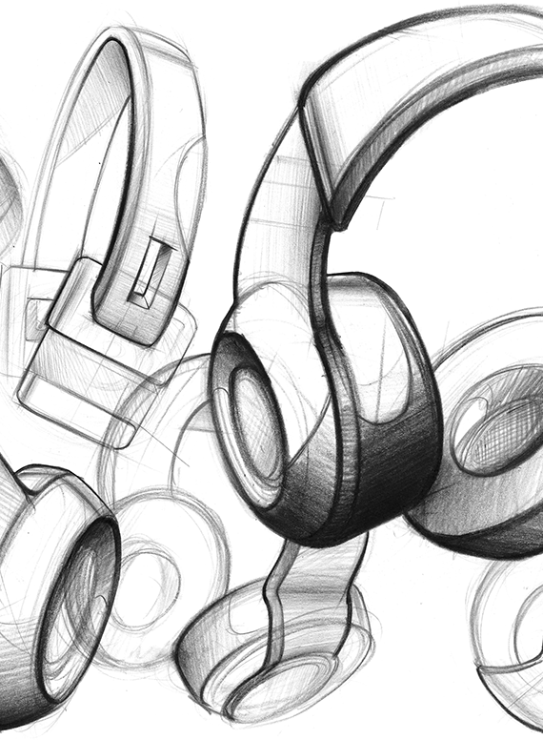

summary
We will go over each of the topics in class.
You will be given examples of past paper questions to complete in class.
You will apply this knowledge to your practice assignment and for the final Assignment, likely to start in the weeks running up to Christmas.
You will be given regular homework to practice answering exam-like questions and to ensure you have the knowledge and understanding to be successful in the Prelim after Christmas and the Final Exam in May 2024.

Slide 11
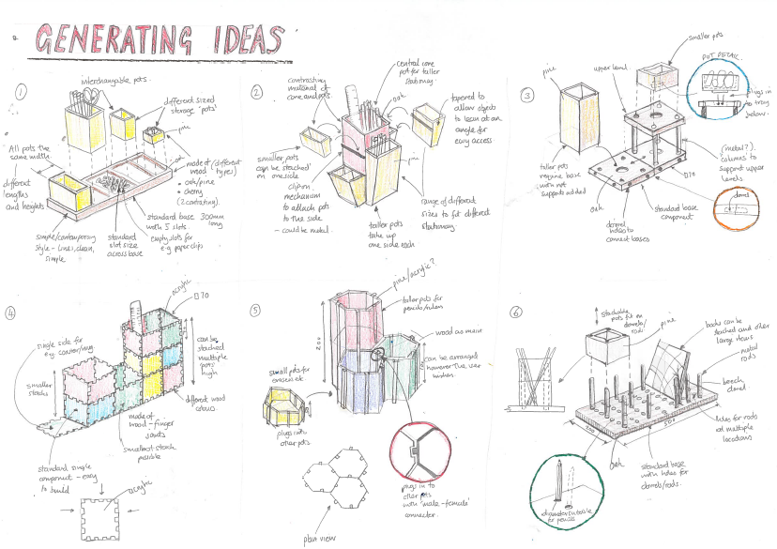
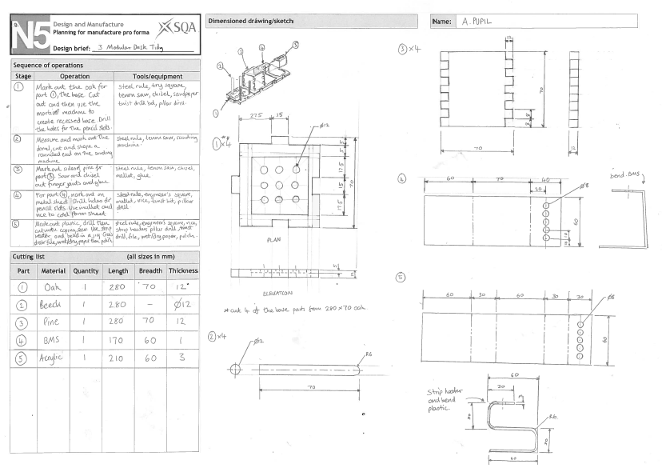
Course assessment
Similarly to National 5, in Higher Design & manufacture, you will be given a choice of three design briefs from the SQA. You will be required to produce a 12 page design folio. Please not: *There is NO manufacture in the Higher course assignment* (Though there is model making).
Overall, the course is assessed as follows:
Course assignment/Added Value Unit = 53% of the total marks.
Final SQA Exam 80 marks (knowledge and understanding of the course theory) = 47% of total marks.

Slide 12
jotters
  You will be given 2 jotters.
  ORANGE:
  Name
  Higher Design and Manufacture Notes
  YELLOW:
  Name
  Higher Design and Manufacture Homework

Slide 13
careers
  There are a number of different careers that Design & Manufacture could lead you to, such as:
  Aerospace engineer
  Agricultural engineer
  Aircraft maintenance engineer
  Architect
  Architectural technician
  Architectural technologist
  Automotive engineer
  Blacksmith
  Carpenter or joiner
  Chemical engineer
  Civil engineering technician
  Construction manager
  Costume designer
  Electrical engineer
  Furniture designer
  Games developer
  Set designer
  And many more…
  To see a full list of potential careers, click on the link below:
  https://www.myworldofwork.co.uk/my-career-options/subjects?group=all&subjects=2991

